Slide 1
Politics in the Algorithmic Age
Course: Global Politics 101
Topic: The Algorithmic Social Contract

Slide 2
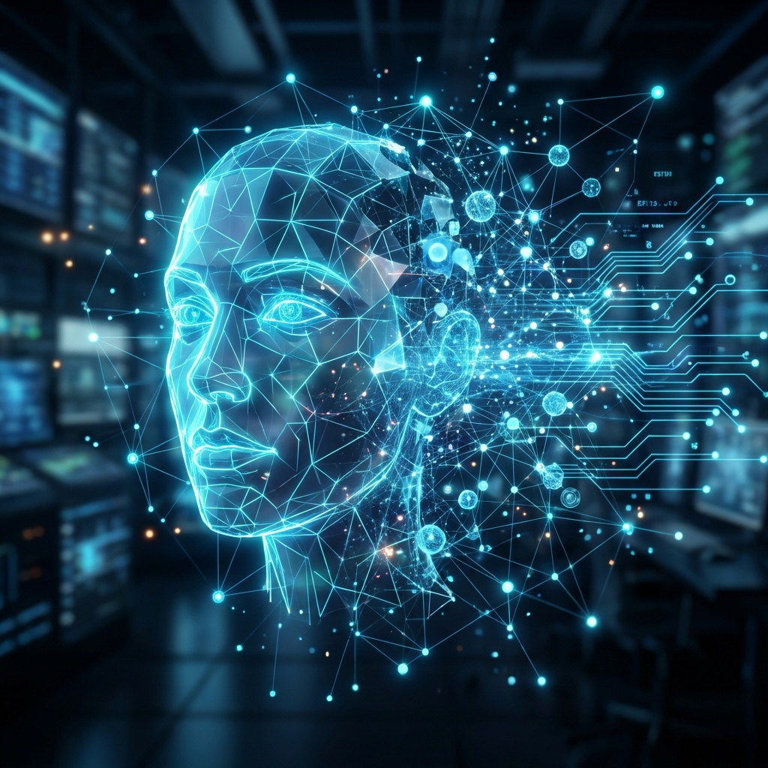
The Algorithmic Age
Definition: We live in an 'Algorithmic Age' where every digital interaction is broken down into Nodes (things) and Edges (attributes).
The Shift: Prior to 2010, the goal was to understand humans. Now, the priority is to predict future behavior.
Key Takeaway: Transition from surveillance for marketing to predictive modeling for behavioral replication.
"If you can be predicted, are you free?"

Slide 3

The Logic of the Social Contract
Theory: Rational actors surrender freedom to a political authority for benefits.
Hobbes: We cede rights for protection (security).
Locke: We cede power to preserve rights (life, liberty).
Rousseau: We submit to the 'General Will' for meaning.
"What rights did you sign away today?"

Slide 4

The Algorithmic Social Contract
The Problem: The internet offers infinite information ('Anxiety of Choice').
The Exchange: We cede curational autonomy to algorithms.
The Benefit: Curated comfort and reduced anxiety.
The Cost: Data extraction and consumer clustering.
"Is comfort worth the cost of your autonomy?"

Slide 5

The Paradox of Expression
The Promise: The internet as a place for the 'authentic self.'
The Reality: Modifying our voice to be 'heard' by the code.
Reflection vs. Voice: Reflection is slow and hard to monetize. Voice is immediate and profitable.
"Are you sharing your life, or performing it?"

Slide 6
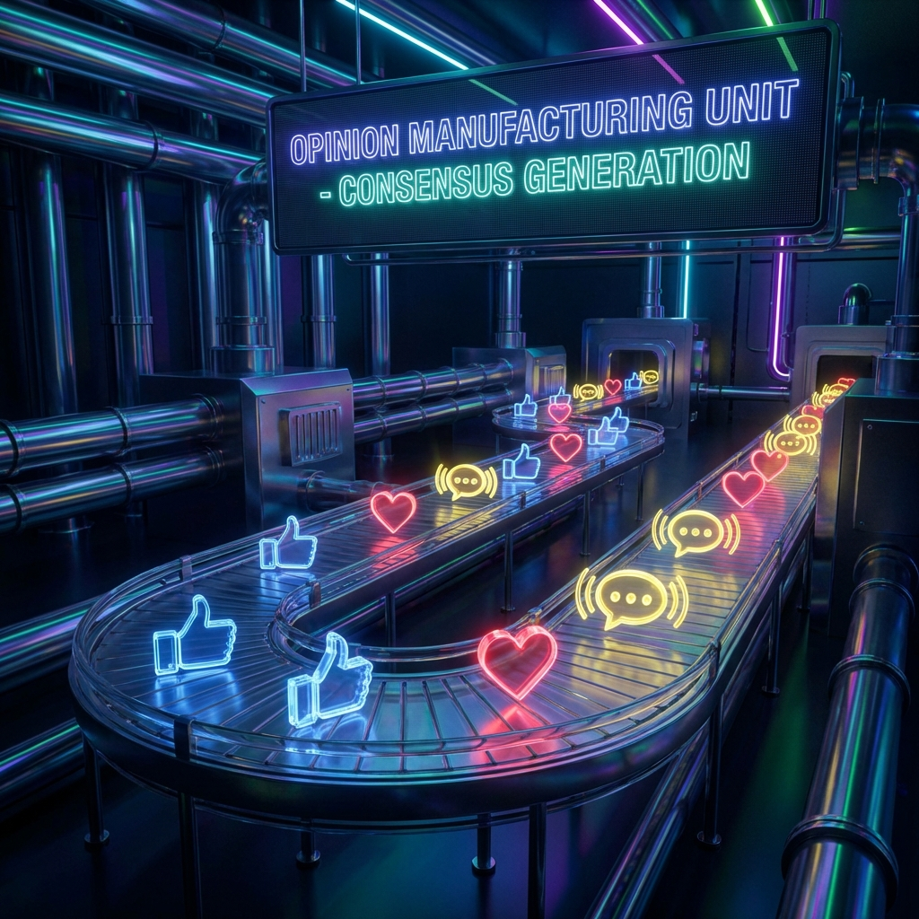
The Economics of Engagement
Datafication: Human expression tokenized for AI training.
Supply & Demand: Platforms need a constant supply of opinion.
Habitual Engagement: 'Voice' becomes a habit, not a thought.
"Who profits from your outrage?"

Slide 7

The Outlier Problem
Traditional Science: Accepted 'outliers' (parsimony).
AI Revolution: Uses billions of parameters to force the model to fit reality.
Goal: Prediction (what happens next) over Explanation (why).
"What parts of you don't fit the model?"

Slide 8
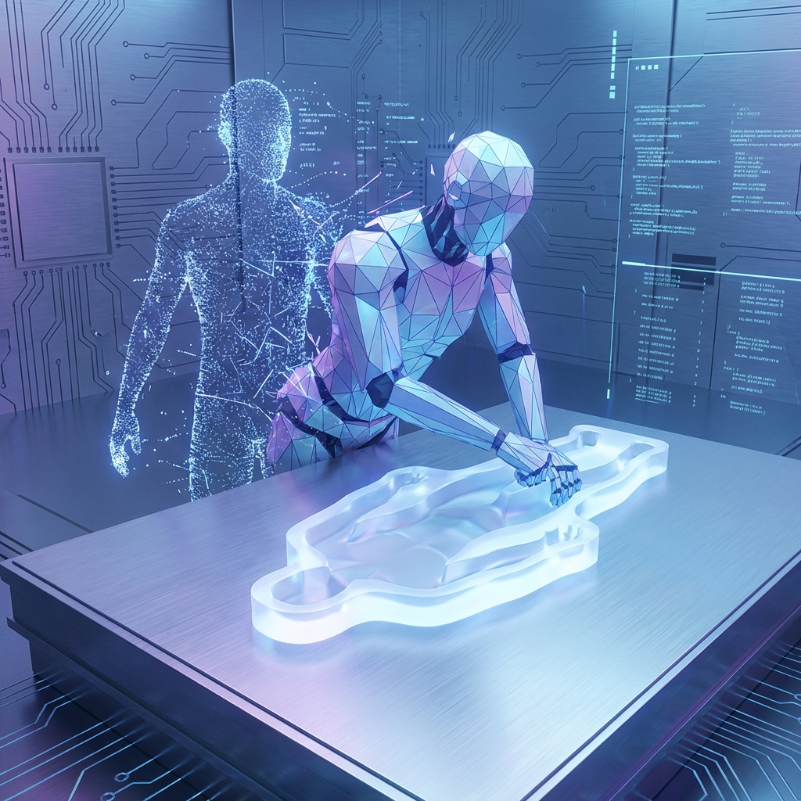
Machine Habitus
The Danger: If we are unpredictable, the system is inefficient.
Machine Habitus: We subconsciously sort and classify ourselves to match the algorithm.
Conclusion: We adapt to the machine's simplicity instead of it adapting to our complexity.
"Are you training the algorithm, or is it training you?"

